Slide 1

HEART DISEASE PREDICTION USING MACHINE LEARNING ALGORITHMS
MINI-PROJECT FINAL PHASE
Presented By:
Apoorva S V 1DS19IS020
Archith K R 1DS19IS021
Karthik S 1DS19IS050
Manasa B 1DS19IS054
Under The Guidance Of
Prof Sreevidya B S
Asst.Professor
Dept. of Information Science and Engineering
DSCE, Bangalore

Slide 2
CONTENTS
Introduction
Problem Statement
Architecture diagram
Use case diagram
Flow Chart diagram
Implementation
Results
Conclusion
References

Slide 3
INTRODUCTION
There are several contributory risk factors for heart disease.
Various Machine Learning algorithms can be applied for effective Heart disease prediction.
K-Nearest Neighbor(KNN),Decision Tree(DT), Support Vector Classifier(SVM), and Random Forest Classifier(RF).

Slide 4
PROBLEM STATEMENT
The major challenge in heart disease is its detection.
Early detection of cardiac diseases can decrease the mortality rate and overall complications. However, it is not possible to monitor patients everyday
Since we have a good amount of data in today’s world, we can use various machine learning algorithms to analyze the data for hidden patterns which can be used for health diagnosis in medicinal data.
The existing model uses Linear Regression, Decision Tree ,Random Forest and KNN to predict the heart disease.
The proposed model will make use of Decision Tree ,Support Vector Classifier, Random Forest Classifier and KNN for Heart disease prediction

Slide 5
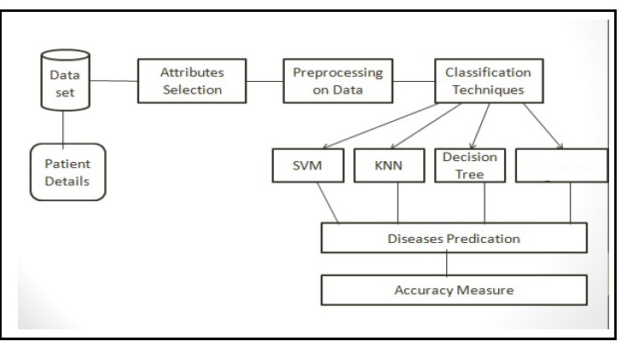
ARCHITECTURE DIAGRAM
Random Forest

Slide 6
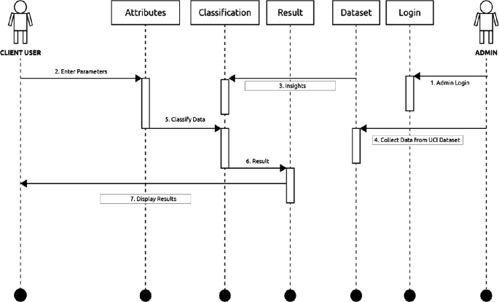
USECASE DIAGRAM

Slide 7
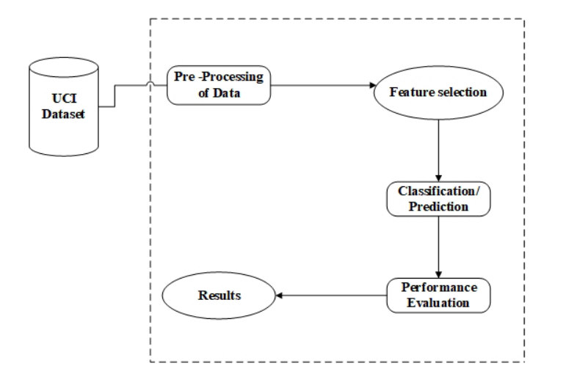
FLOW CHART DIAGRAM

Slide 8
IMPLEMENTATION
In this machine learning project, the UCI dataset is collected and Machine Learning is used to make predictions on whether a person is suffering from Heart Disease or not.
To split the available dataset for testing and training, the train_test_split method is used. To scale the features, StandardScaler is used.
The dataset is stored in the file dataset.csv. the pandas read_csv method is used to read the dataset.
Next step is to understand the data by Datavisualizations using correlation matrix and histograms.
Next step is Data Processing using StandardScaler from sklearn to scale the dataset.

Slide 9
IMPLEMENTATION
After exploring the dataset, it is observed that there is a need to convert some categorical variables into dummy variables and scale all the values before training the Machine Learning models. First, the get_dummies method is used to create dummy columns for categorical variables.
Now train_test_split is imported to split the dataset into training and testing datasets. Then, all Machine Learning models are imported and is used to train and test the data.
Now K Neighbors Classifier is implemented.
The classification score varies based on different values of neighbors that is chosen. Thus, score graph is plotted for different values of K (neighbors) and checked when best score is achieved.

Slide 10
IMPLEMENTATION
Now Support Vector Classifier is implemented .
There are several kernels for Support Vector Classifier. some of them('linear', 'poly', 'rbf', 'sigmoid’) is tested and checked which has the best score.
Now “Decision Tree Classifier” is implemented for the dataset.
Here, the Decision Tree Classifier is used to model the problem at hand. A variation between a set of max_features is made to see which returns the best accuracy.
Now implement “Random Forest Classifier” is implemented for our dataset.
Then Random Forest Classifier is used to create the model and vary the number of estimators to see their effect.
The model is trained and the scores are recorded.Then bar graph is plotted to compare the scores.

Slide 11
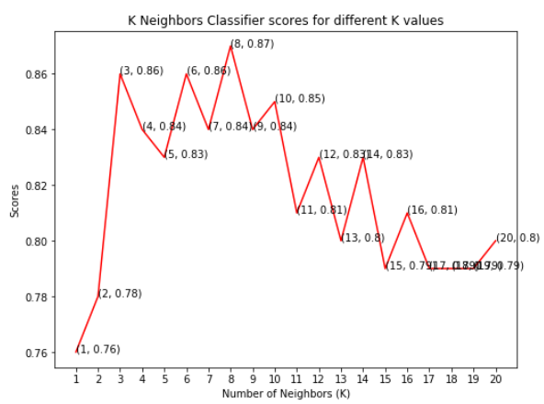
that the maximum score achieved was 0.87 for the 8 neighbors
that the maximum score achieved was 0.87 for the 8 neighbors
that the maximum score achieved was 0.87 for the 8 neighbors
that the maximum score achieved was 0.87 for the 8 neighbors
RESULTS
The maximum score achieved was 0.87 at K value 8

Slide 12
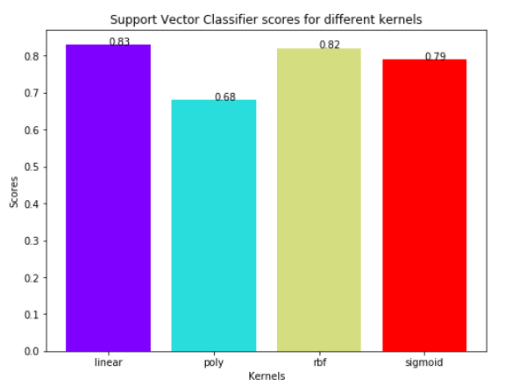
RESULTS
The linear kernel performed the best with 0.83 accuracy

Slide 13
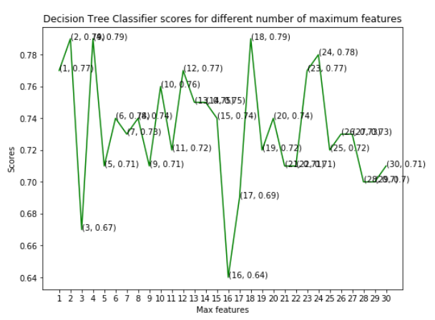
The model achieved the best accuracy at three values of maximum features, 2, 4 and 18
RESULTS
The model achieved the best accuracy of 0.79 at the three values of maximum features 2,4 and 18

Slide 14
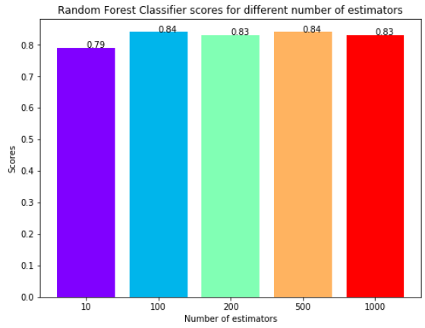
RESULTS
The maximum score of 0.84 is achieved when total estimators are 100 or 500

Slide 15
CONCLUSION
In this project, we used Machine Learning to predict whether a person is suffering from a heart disease or not. After importing the data, we analysed it using plots. Then, we generated dummy variables for categorical features and scaled other features. Then we applied four Machine Learning algorithms, K Neighbors Classifier, Support Vector Classifier, Decision Tree Classifier and Random Forest Classifier. We varied parameters across each model to improve their scores. In the end, K Neighbors Classifier achieved the highest score of 87% with 8 nearest neighbors

Slide 16
REFERENCES
[1]Archana sing and Rakesh kumar presented “Heart disease prediction using Machine learning Algorithms in 2020-2020 International Conference on Electrical and Electronics Engineering (ICE3-2020), pp. 452-457
[2]Mamatha Alex P and Shaicy P Shaji,“Prediction and Diagnosis of Heart Disease Patients using Data Mining Technique”, 2019.-2019 International Conference on Communication and Signal Processing (ICCSP), 2019,pp. 0848-0852
[3]Bo Jin ,Chao Che, Zhen Liu, Shulong Zhang, Xiaomeng Yin,
And Xiaopeng Wei, “Predicting the Risk of Heart Failure With
EHR Sequential Data Modeling”-in IEEE Access, vol. 6, pp. 9256-9261

Slide 17


